Slide 1
2025 08 14 MSc Defence Joshua Issa
Convective-Reactive Nucleosynthesis in Oxygen-Carbon Shell Mergers
Falk Herwig Iris Dillmann

Slide 2
Massive stars and the origin of the P nuclei

Slide 3
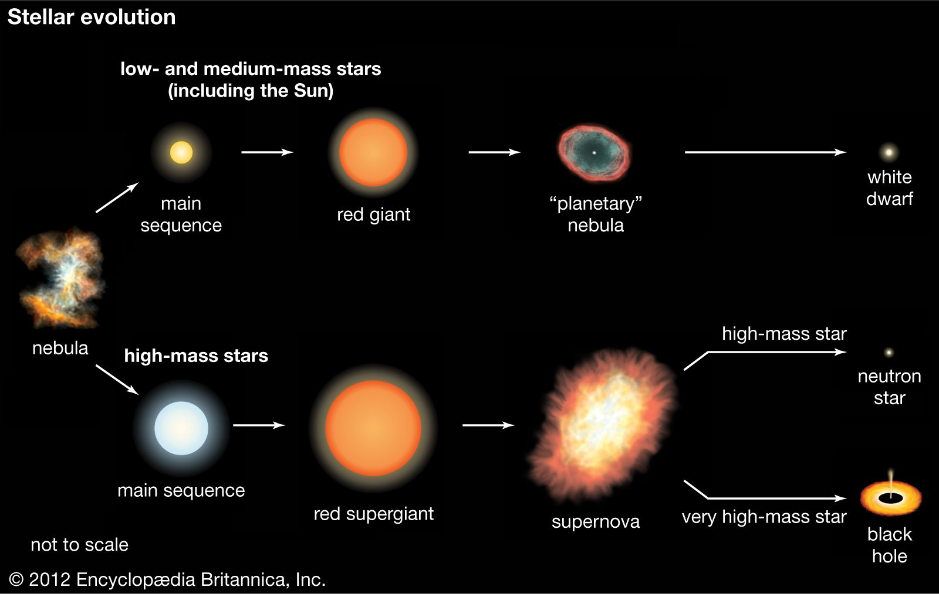
1

Slide 4
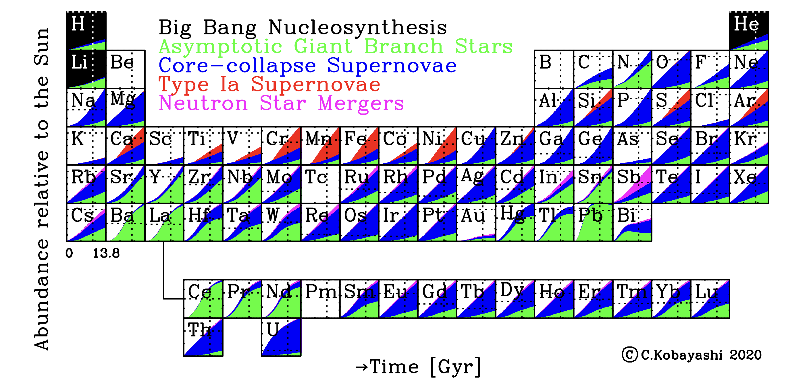
2

Slide 5
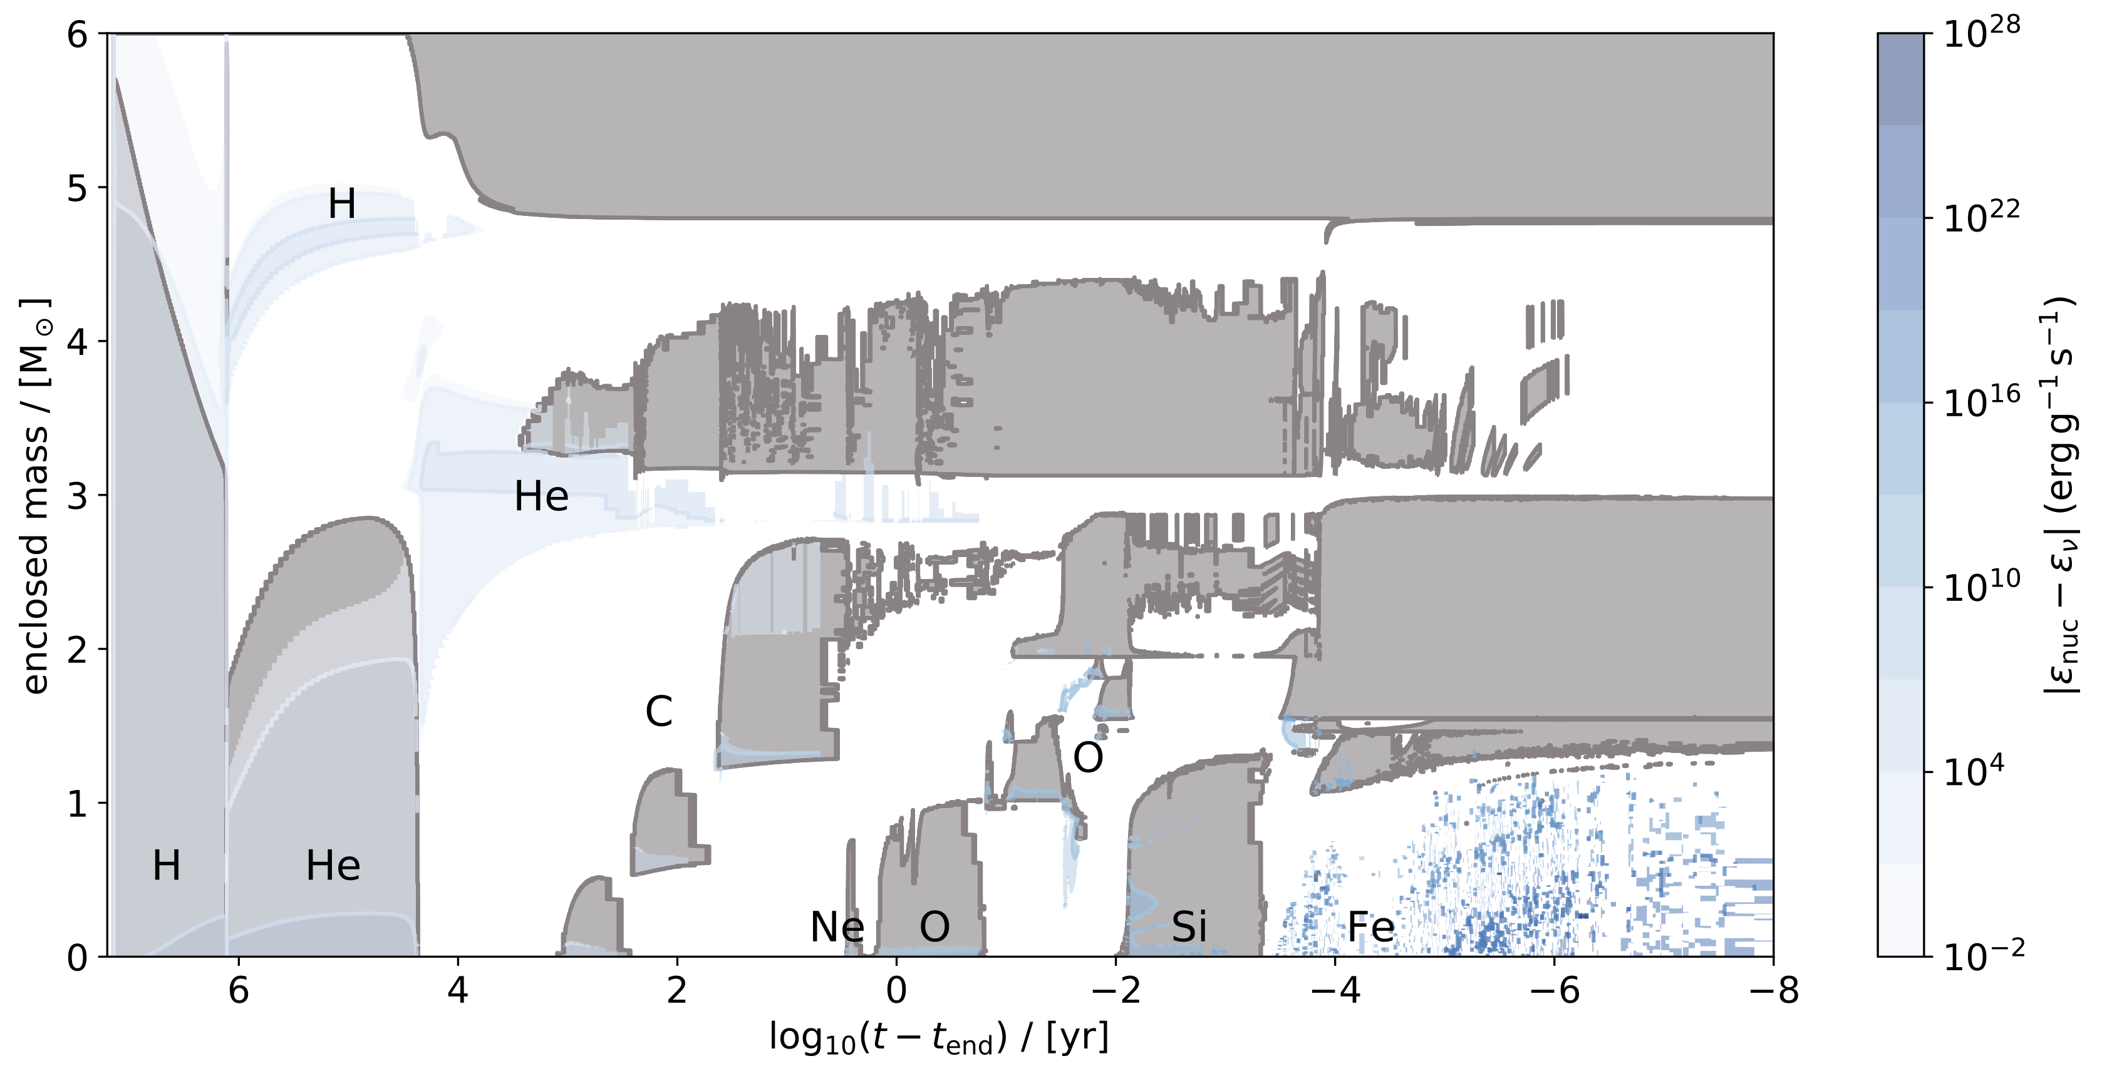
Massive star burning stages
3

Slide 6
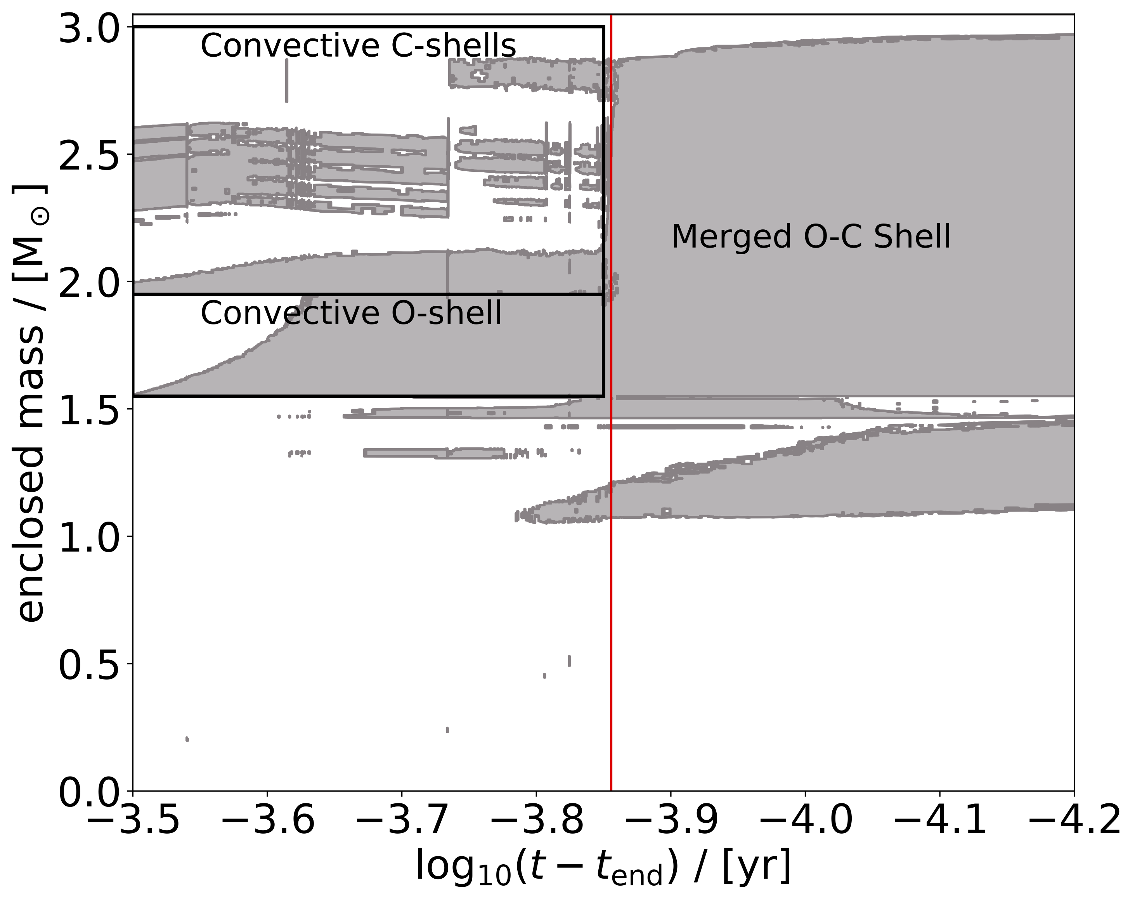
O-C shell mergers
Late stage in stellar evolution
20% of 1D massive star models have a shell merger (Roberti+2025)
Merger in 1D happens because upper boundary of the O-shell entrains carbon and neon
4

Slide 7
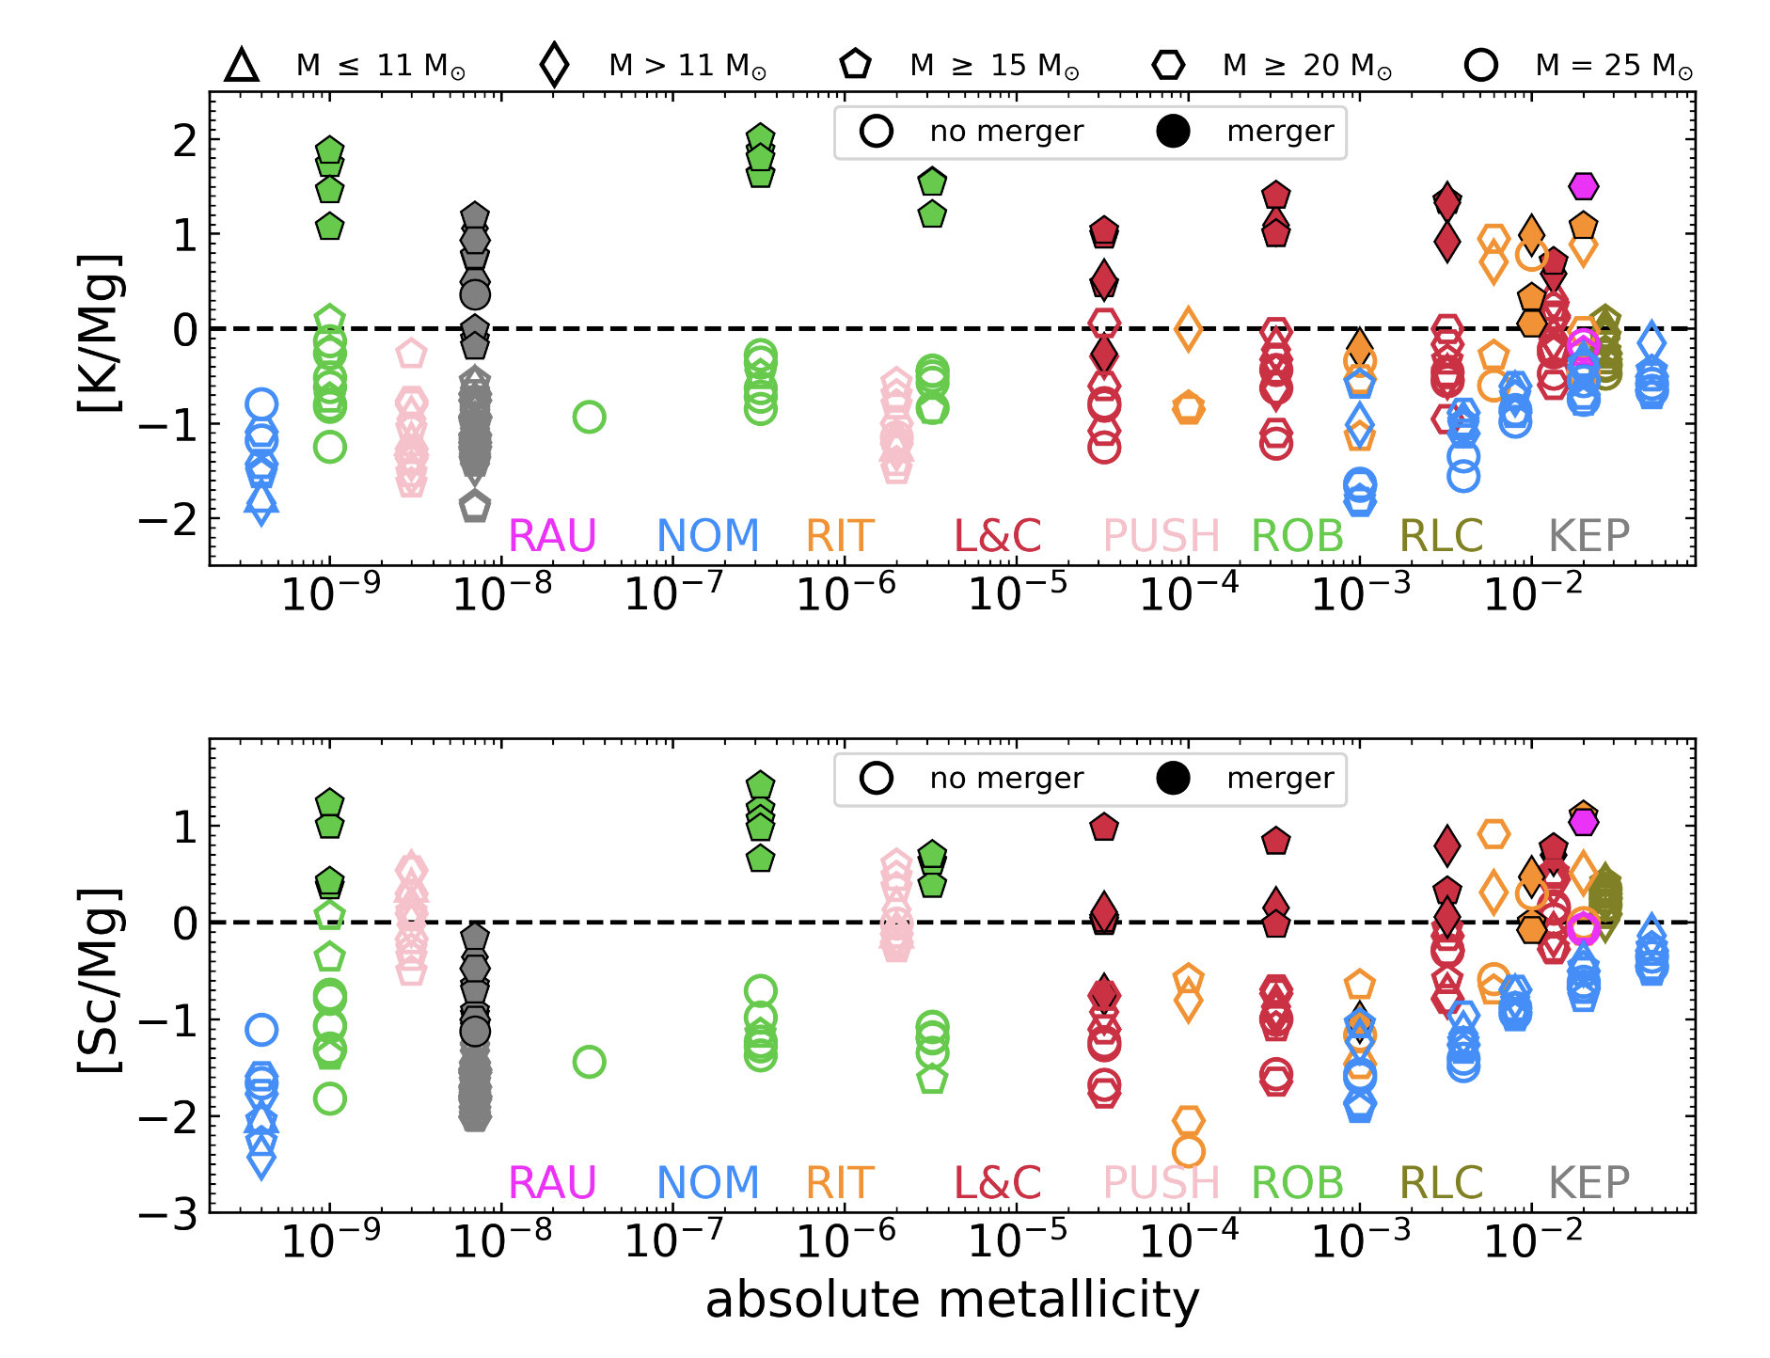
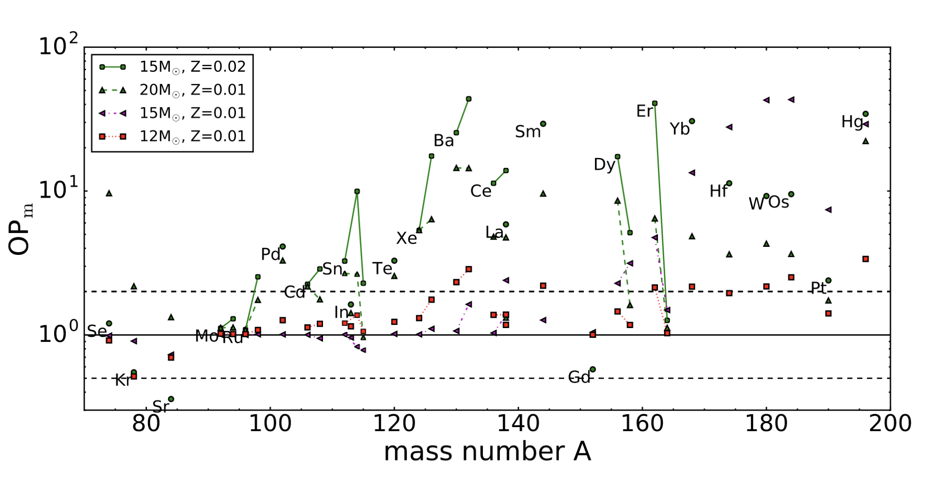
Unique nucleosynthesis during merger
Light odd-Z elements
The p nuclei
Ritter+2018
Roberti+2025
5

Slide 8
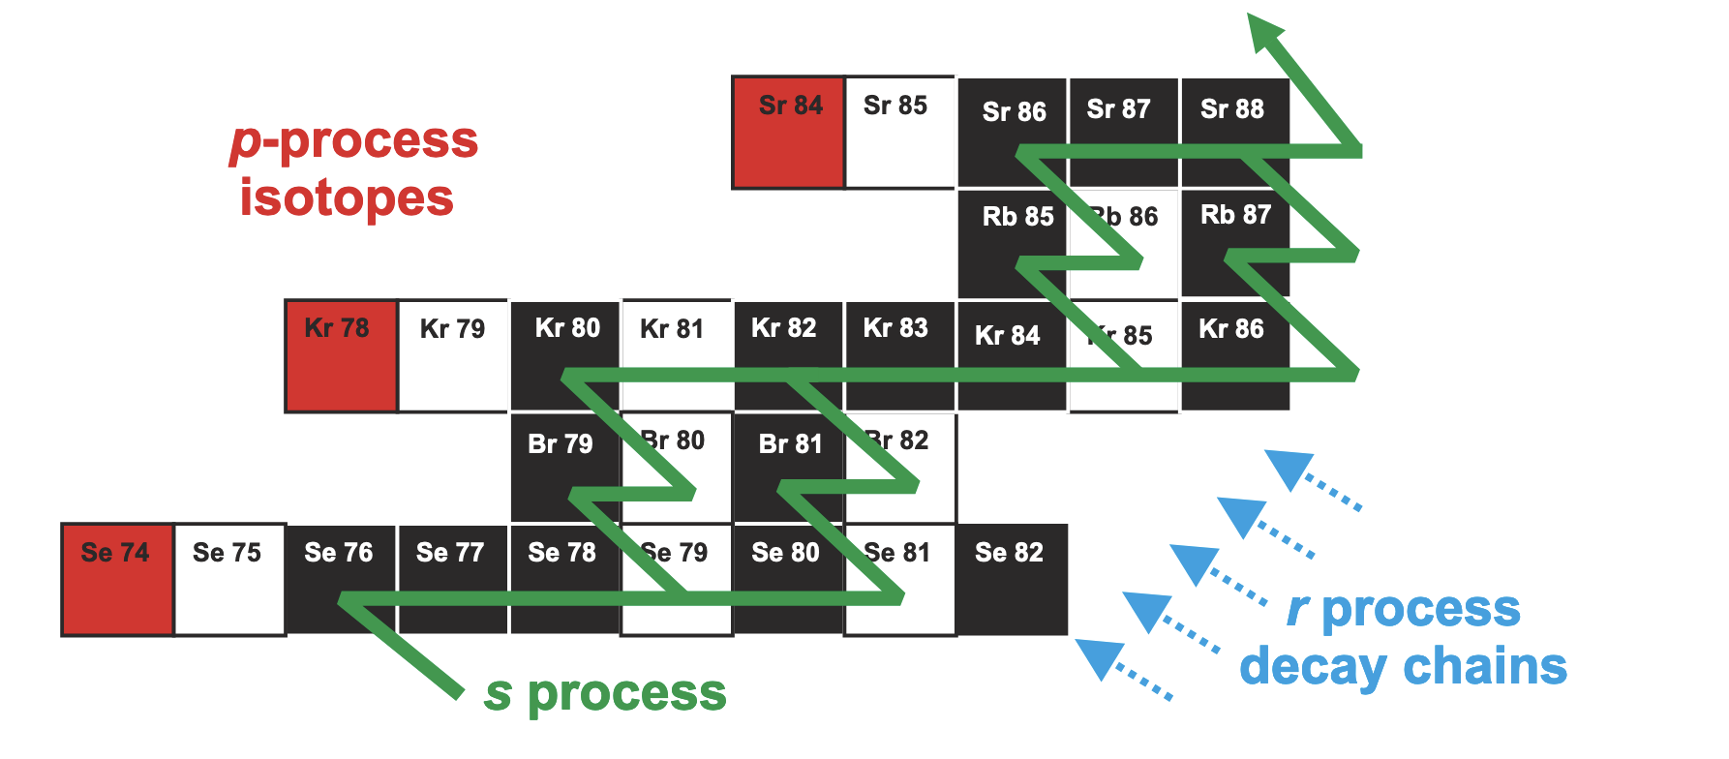
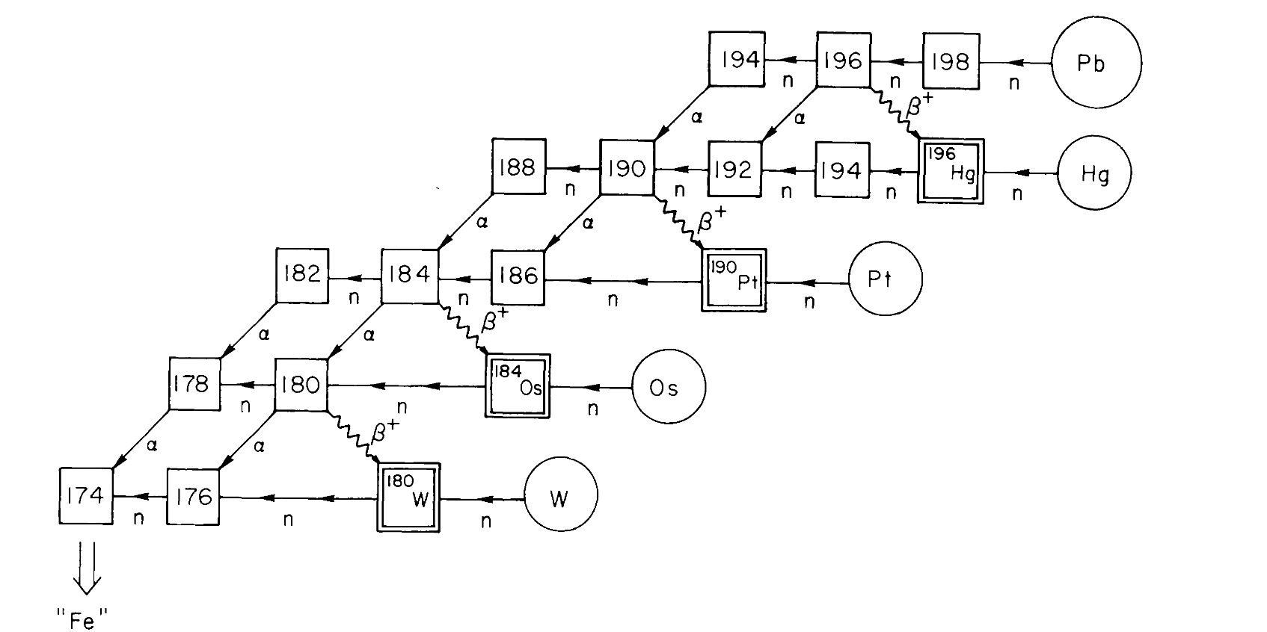
P nuclei and the 𝛾 Process
Rauscher+2013
Woosley & Howard 1978
𝛾 process is a series of photodisintegrations at 2–3.5 GK
Conditions are met during explosive burning and O-C merger
6

Slide 9
Mixing in stars

Slide 10
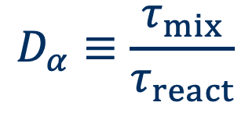
Convective-reactive nucleosynthesis
The O-shell is convective-reactive (Ritter+2018; Yadav+2020)
Occurs when the timescales for mixing and burning are equal (Dimotakis 2005)
Composition is no longer homogenized by mixing
Temperature varies across the shell
$$D_{α}≡\frac{τ_{mix}}{τ_{react}}$$
7

Slide 11
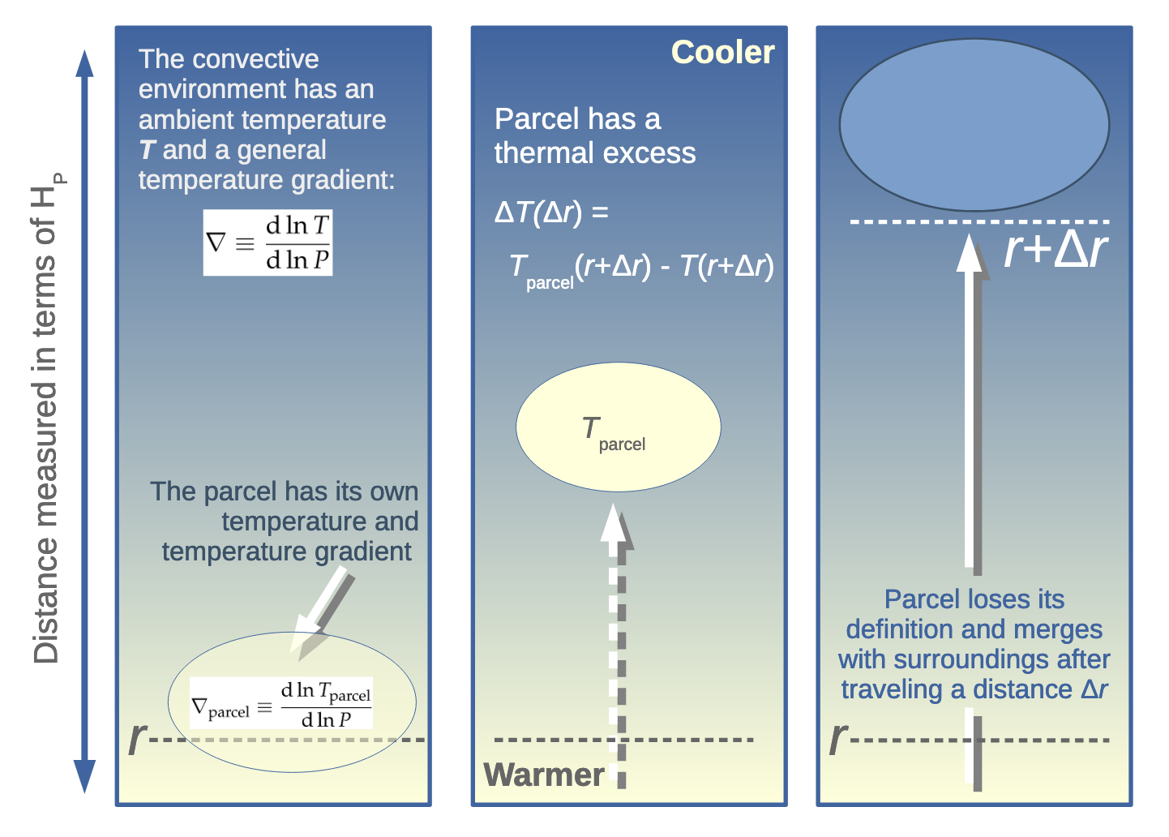
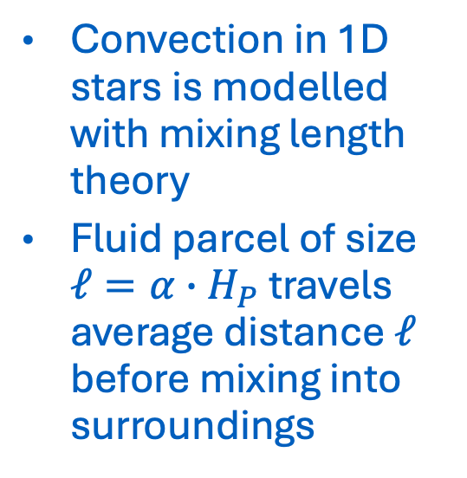
Mixing Length theory
Convection in 1D stars is modelled with mixing length theory
Fluid parcel of size $ℓ=α∙H_{P}$ travels average distance $ℓ$ before mixing into surroundings
Joyce & Tayar 2023
8

Slide 12
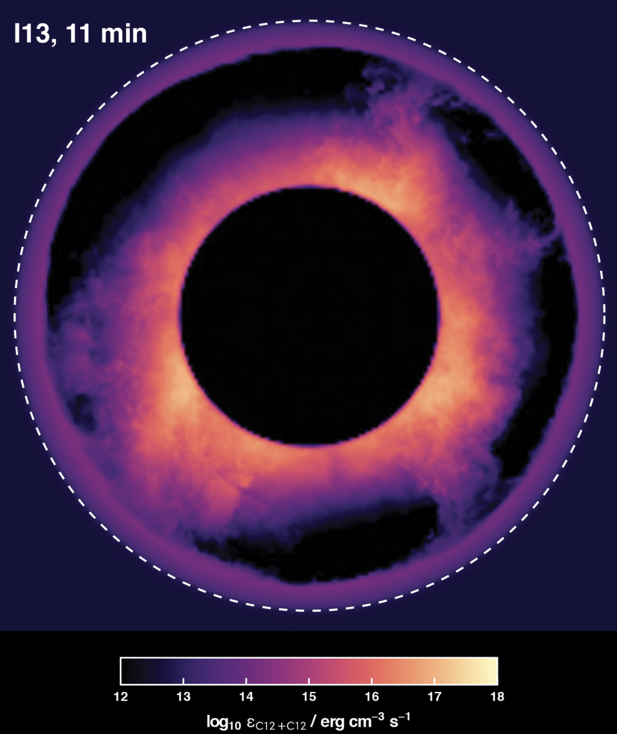
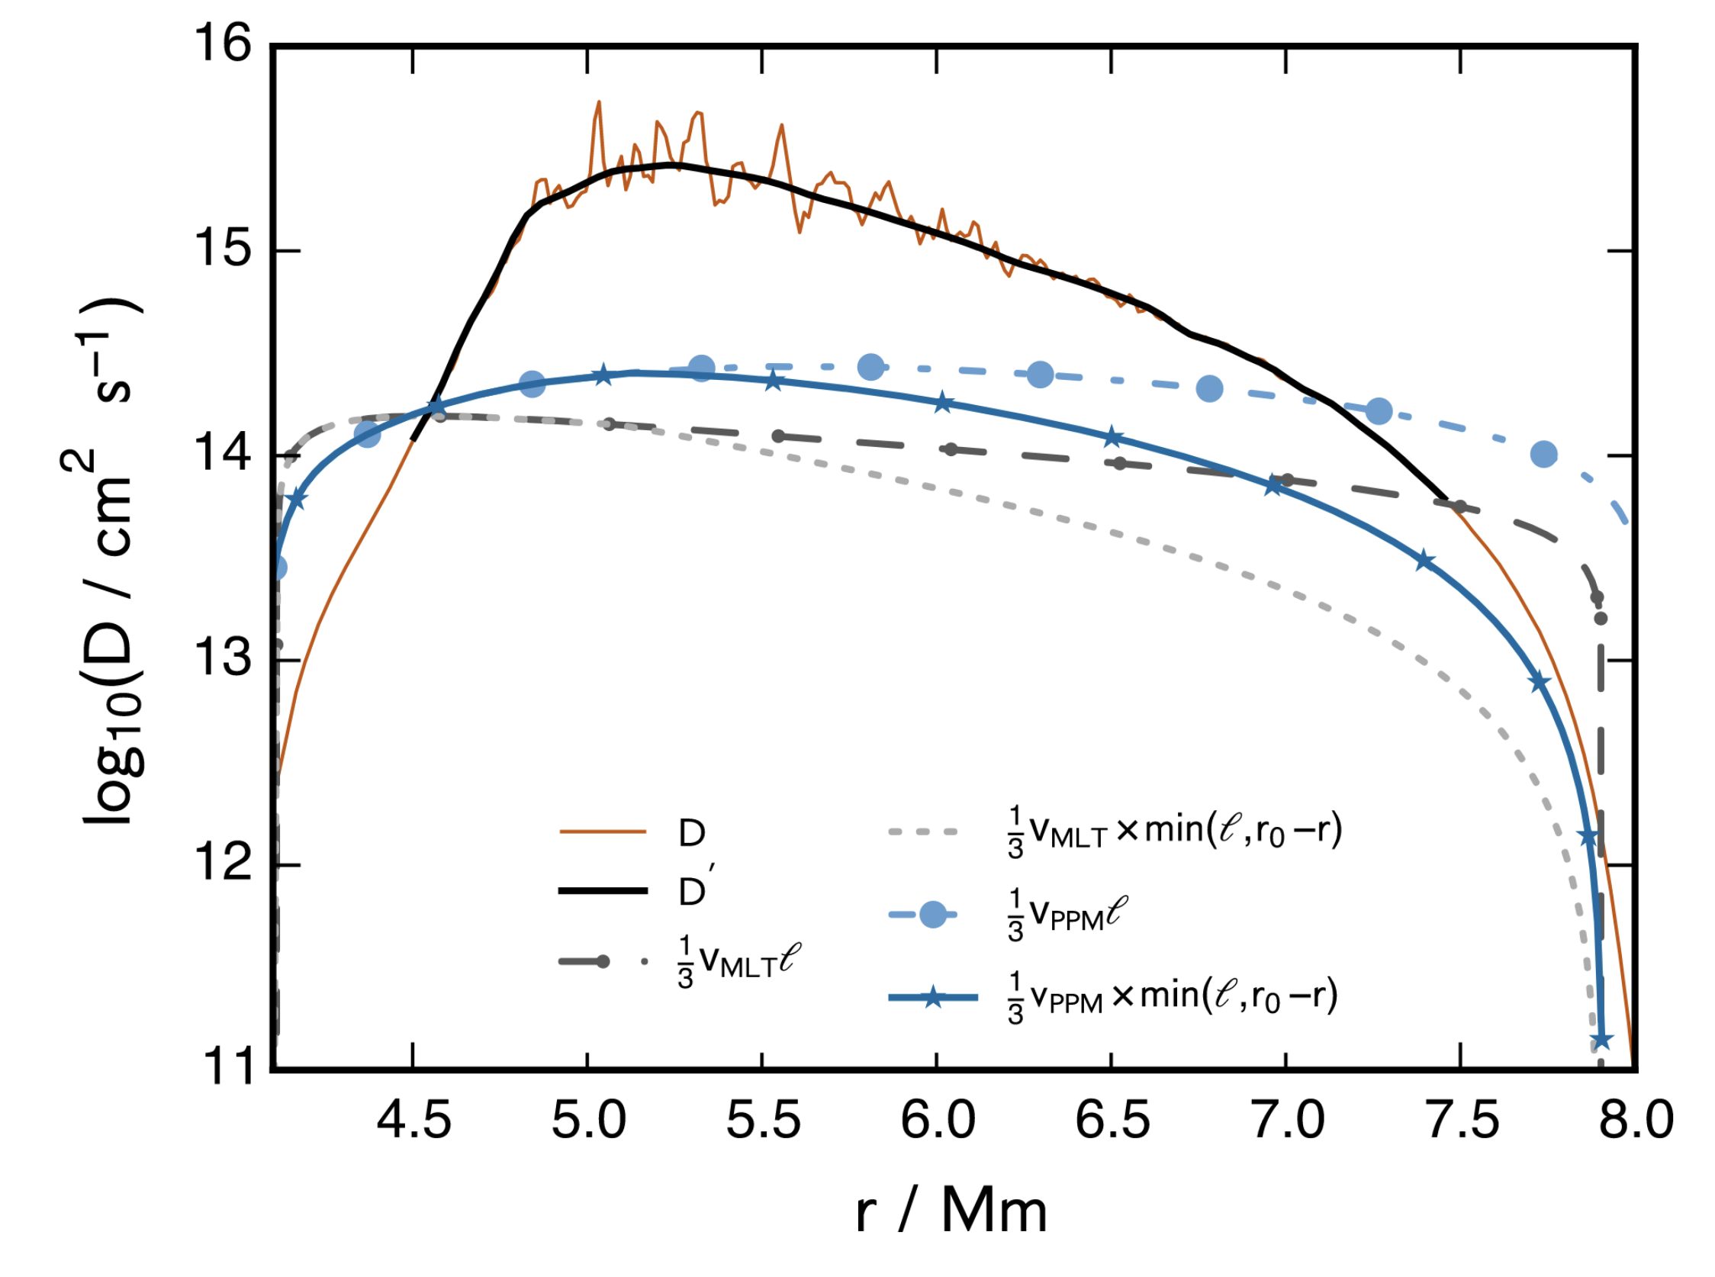
3D hydrodynamics
3D
MLT
Jones+2017
Andrassy+2020
9

Slide 13
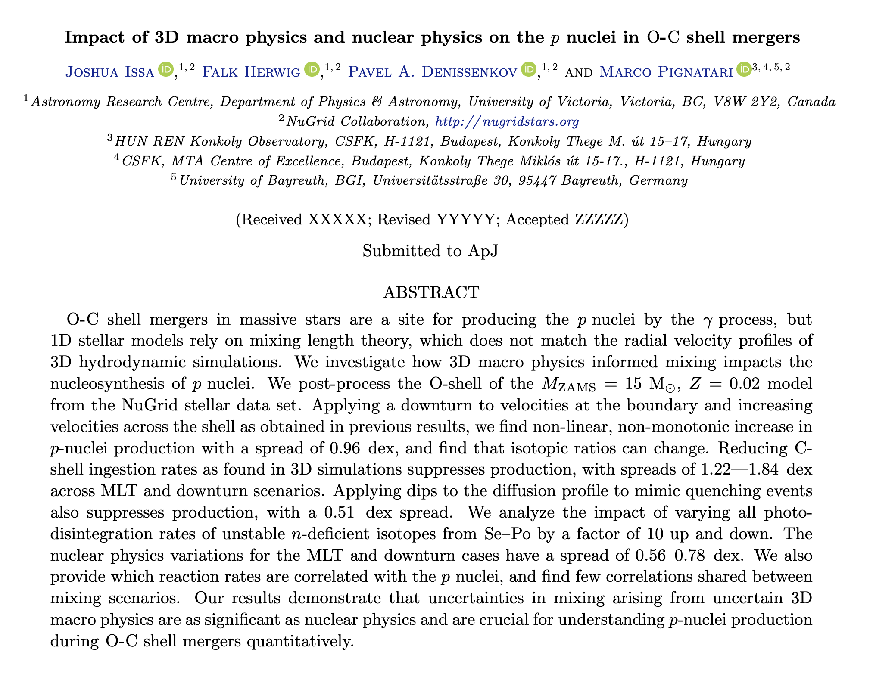

Slide 14
Modelling
Took the 15 M☉ Z=0.02 NuGrid model from Ritter+2018
Post-processed the O-shell with mppnp for 110 seconds
$∆t$=0.01 seconds and 404 mass zones
∆𝑡=0.01 seconds and 404 mass zones
10

Slide 15
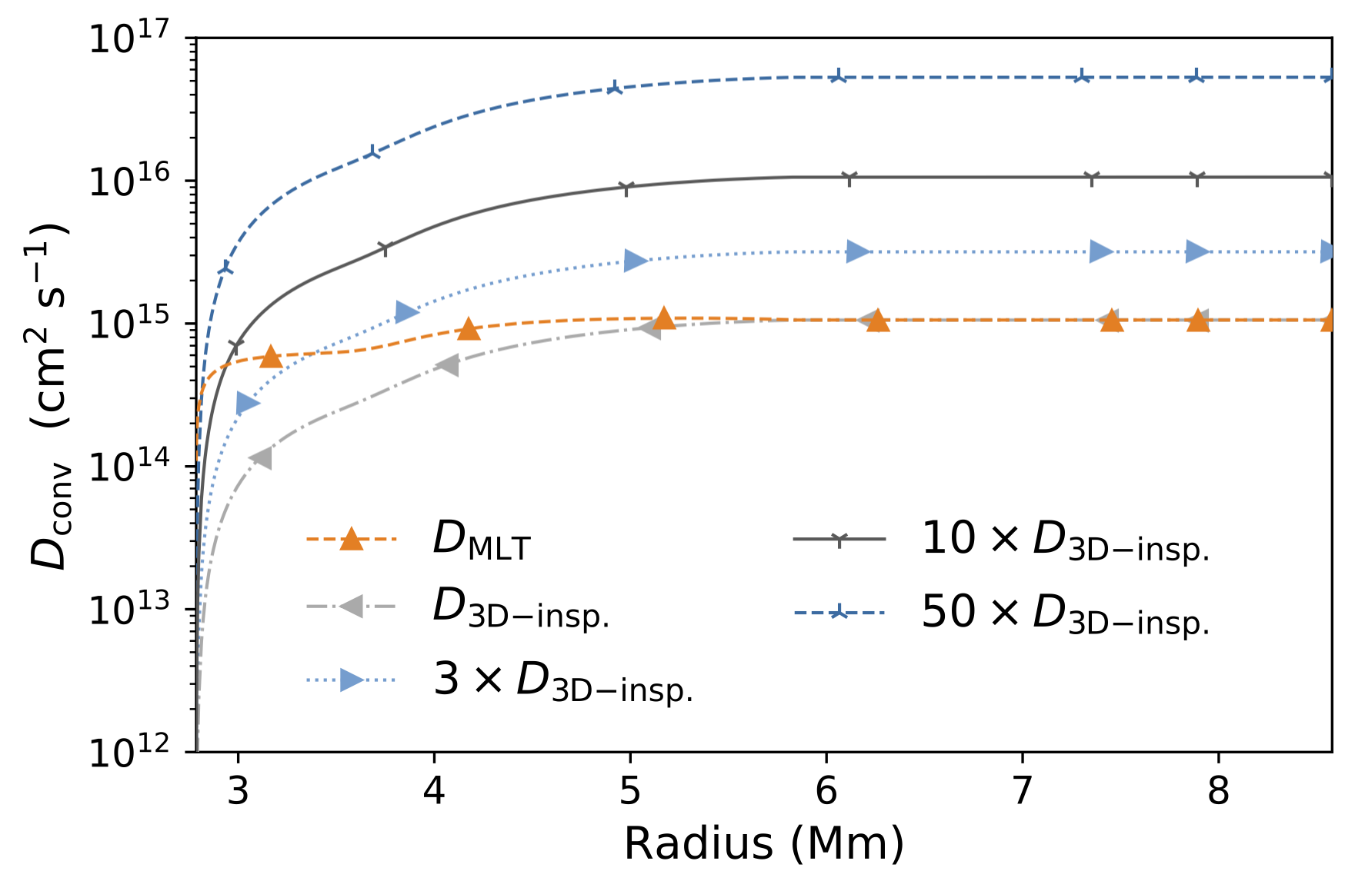
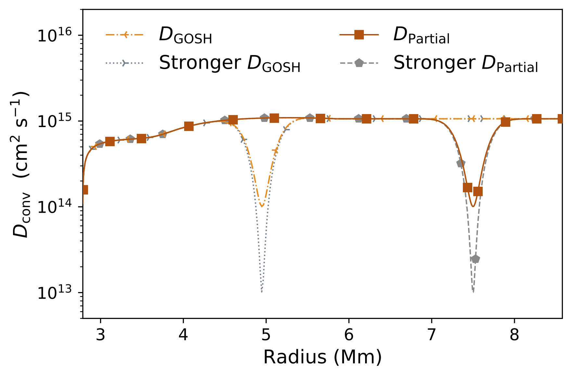
Determining Mixing impact
Downturn at boundary (Meakin+ 2006, 2007; Jones+2017)
Boost in mixing (Jones+2017; Andrassy+2020; Rizzuti+2024)
Lowering ingestion rates (Andrassy+2020)
Convective quenching from partial merger and energy feedback (Andrassy+2020)
11

Slide 16
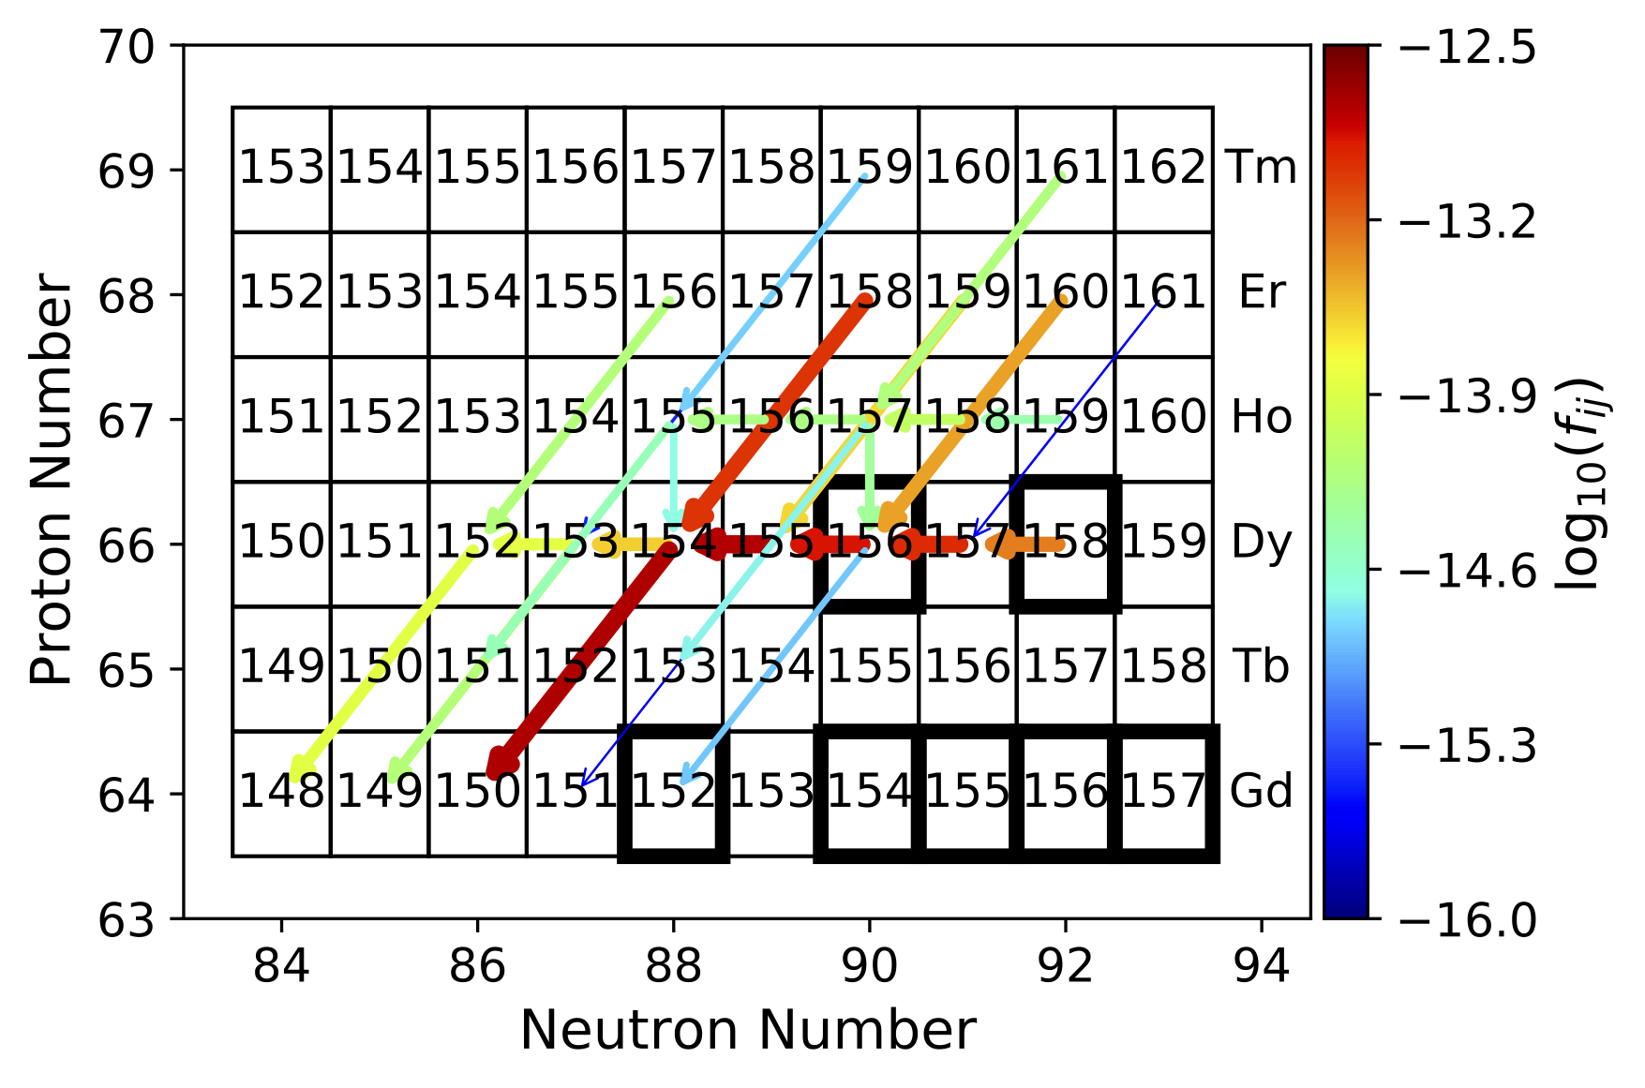
Determining reaction impact
Varied all photodisintegration rates for unstable n-deficient isotopes from Se-Po up and down by a factor of 10 (Denissenkov+2018, 2021)
Relevant reaction rates correlated with isotope production are determined
12

Slide 17
Impact from mixing and reactions

Slide 18
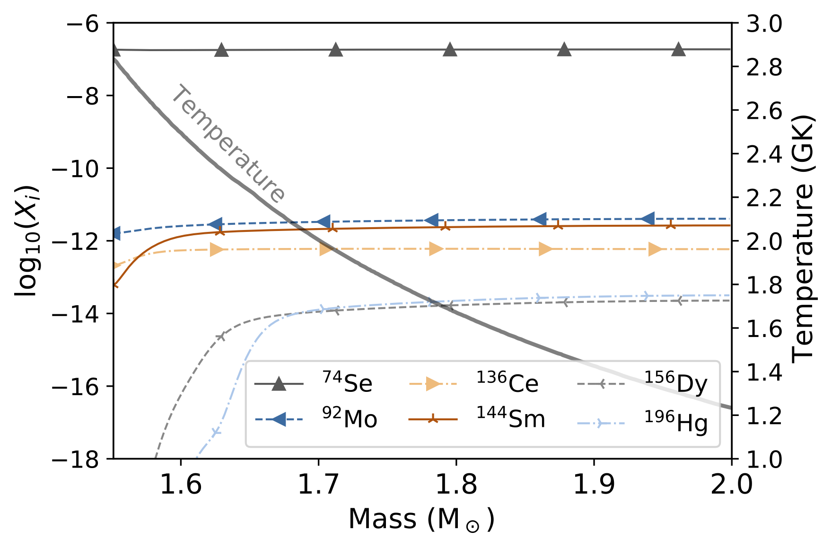
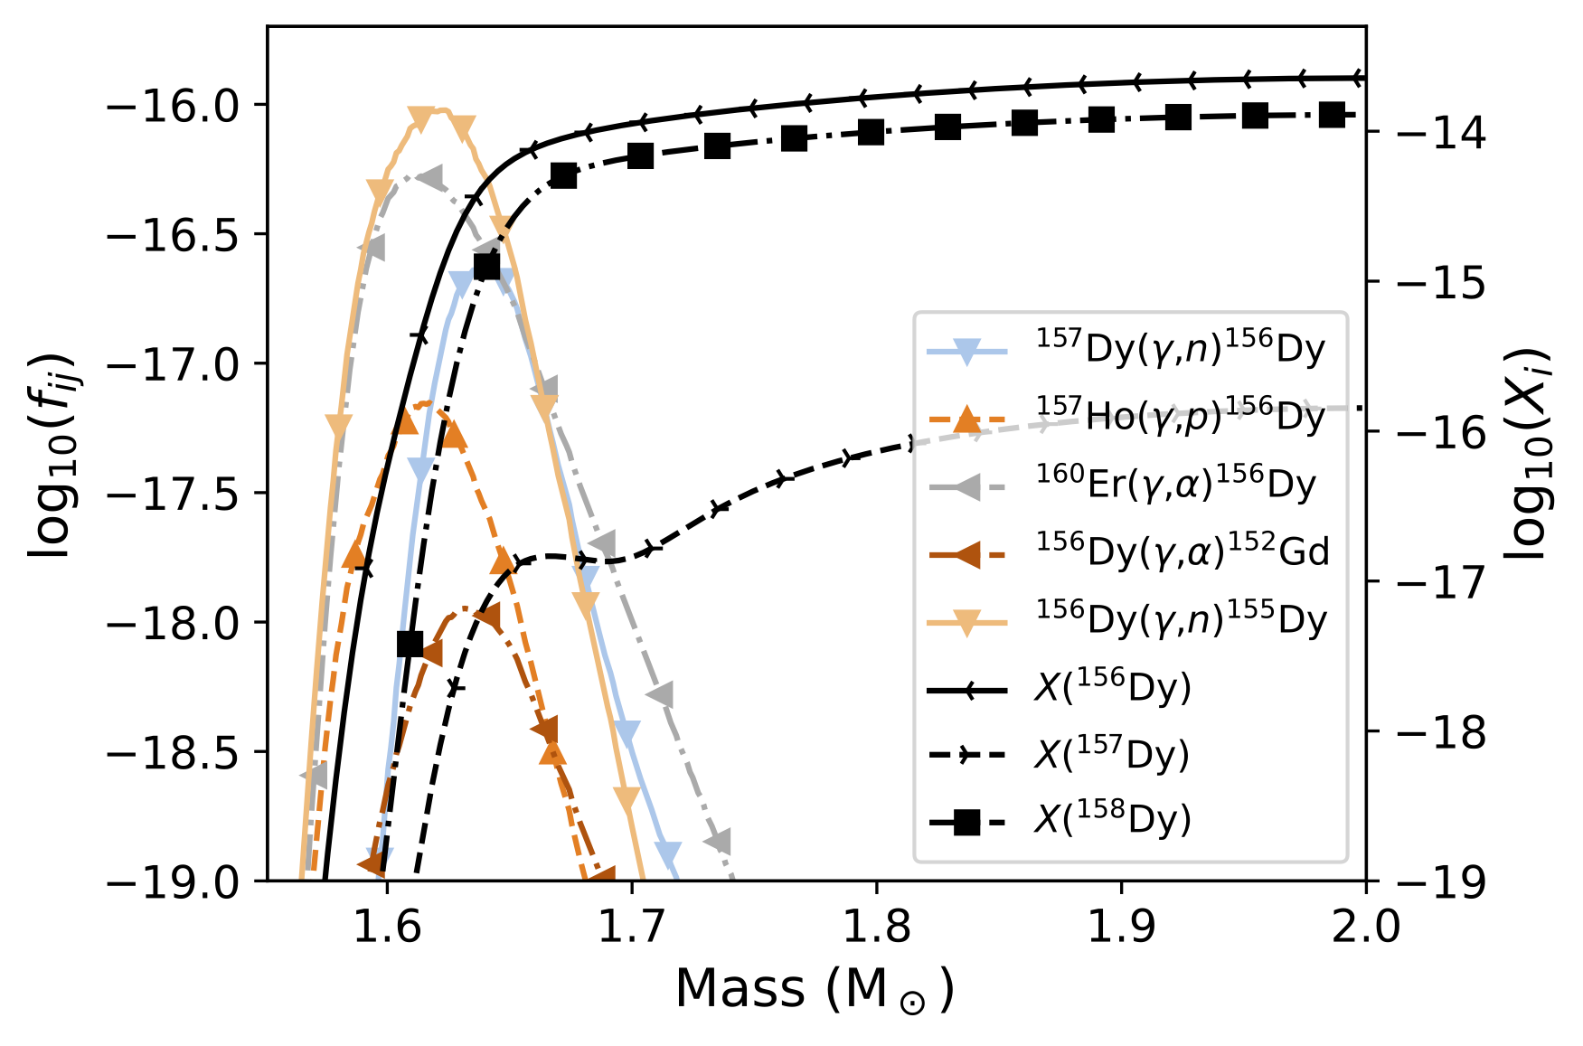
Nucleosynthesis in the merger
13

Slide 19
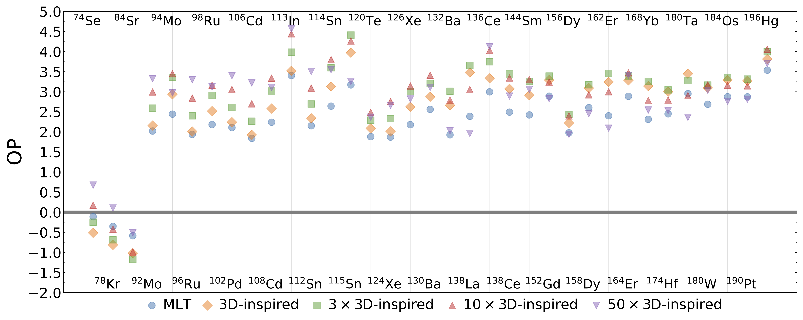

Velocities impact BY AVERAGE factor of 9
$$OP=\log_{10}\left(X_{final}÷X_{initial}\right)$$
Non-monotonic change and impacts pairs differently
14

Slide 20
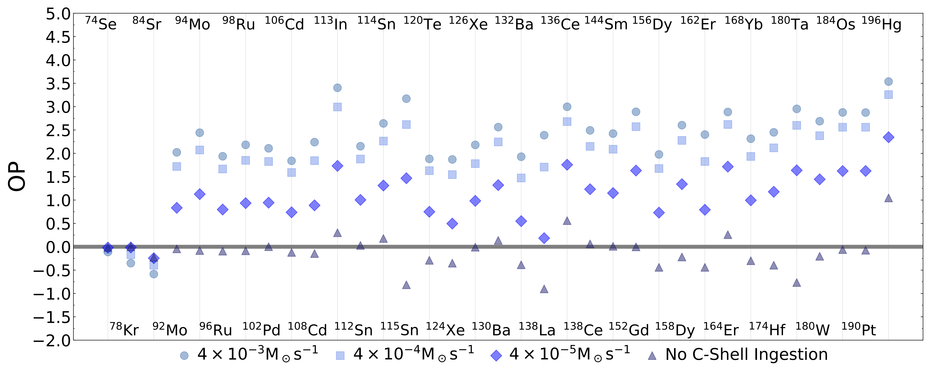
Ingestion rate impacts up to average factor of 70
$$OP=\log_{10}\left(X_{final}÷X_{initial}\right)$$
15

Slide 21
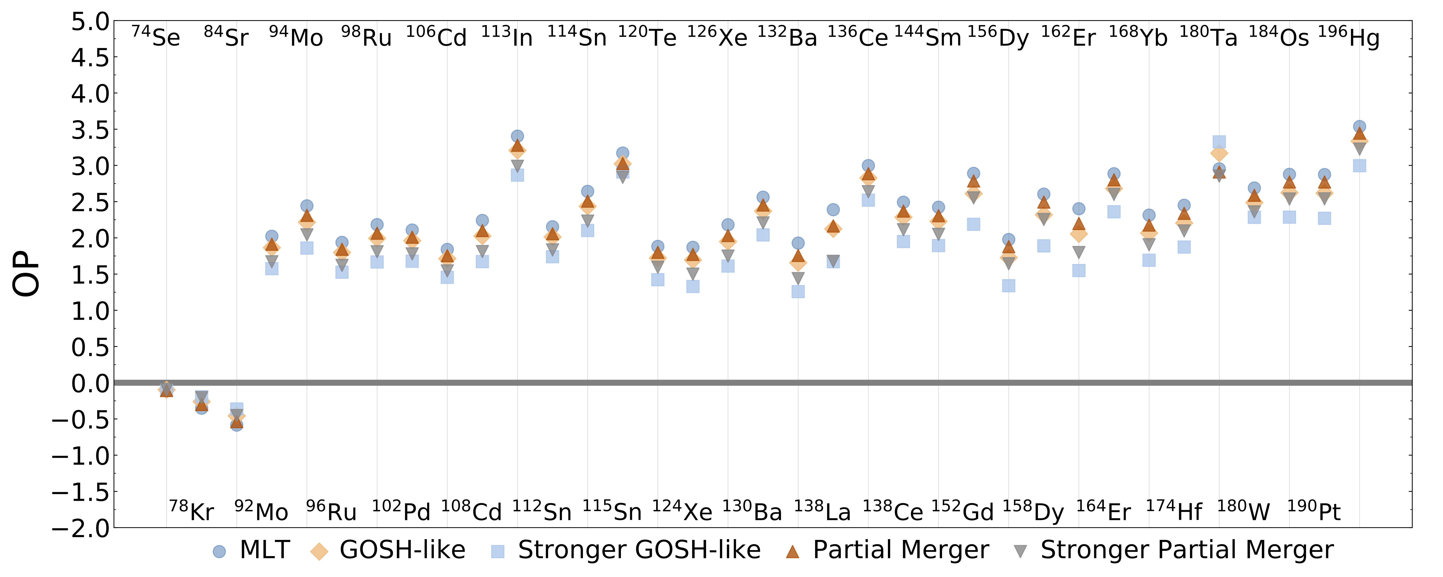
Quenching reduces by average factor of 4
$$OP=\log_{10}\left(X_{final}÷X_{initial}\right)$$
16

Slide 22
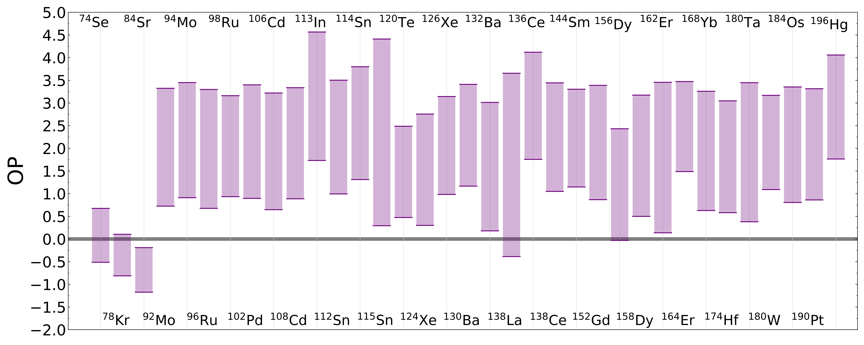
Mixing overall impacts by average factor of 280
$$OP=\log_{10}\left(X_{final}÷X_{initial}\right)$$
17

Slide 23
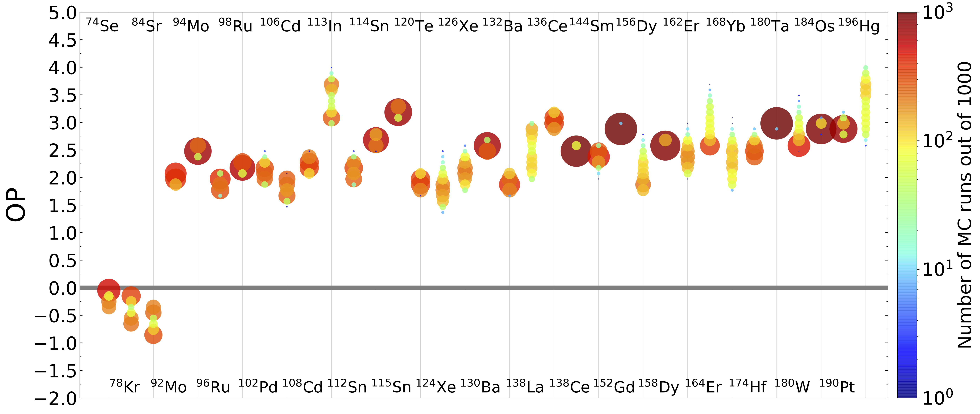
Nuclear reactions impact up to average factor of 6
$$OP=\log_{10}\left(X_{final}÷X_{initial}\right)$$
18

Slide 24
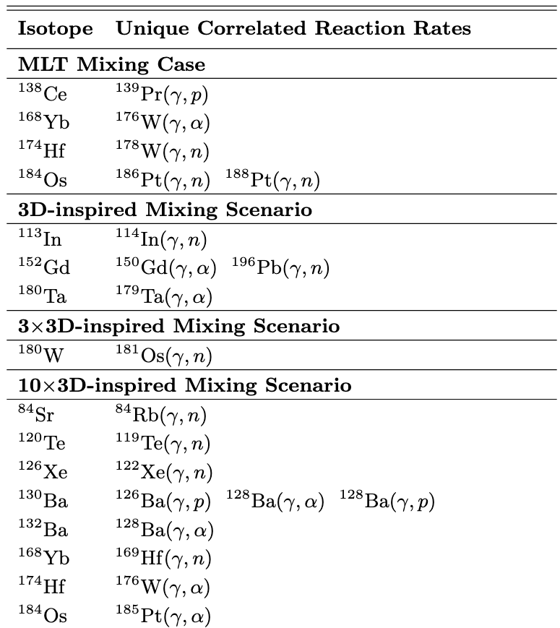
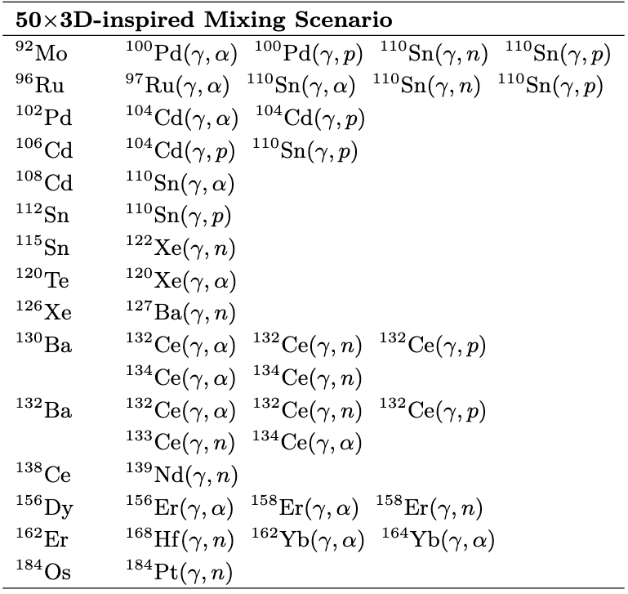
Correlations depend on mixing conditions
19

Slide 25
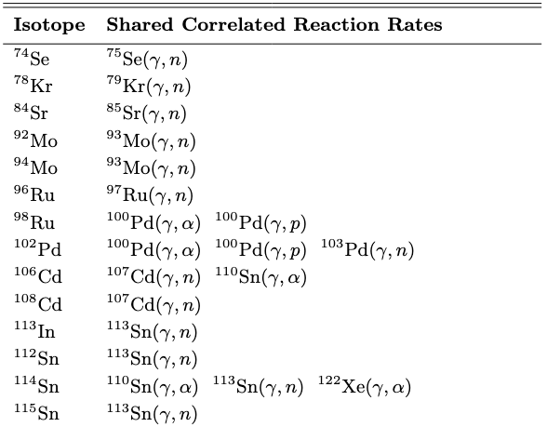
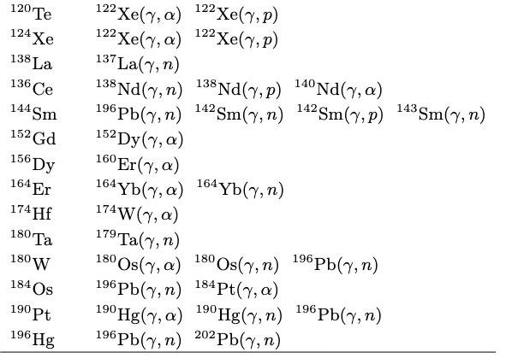
shared correlations across all cases
20

Slide 26
Conclusions
Mixing details significantly impact nucleosynthesis in the merger
Mixing impact can be non-monotonic and affects isotopic ratios
Correlated reaction rates depend on the mixing conditions
Spread in nuclear reaction impact depends on the mixing conditions
21

Slide 27
Post-processing
MESA and mppnp solve the equations of mixing and burning differently because MESA solves stellar structure, mixing, and nuclear reactions together, whereas mppnp splits the operators.
This allows for mppnp to calculate a large network, but requires you to do a resolution study to ensure you resolve both timescales.

Slide 28
Light odd-z elements are also impacted by mixing

Slide 29
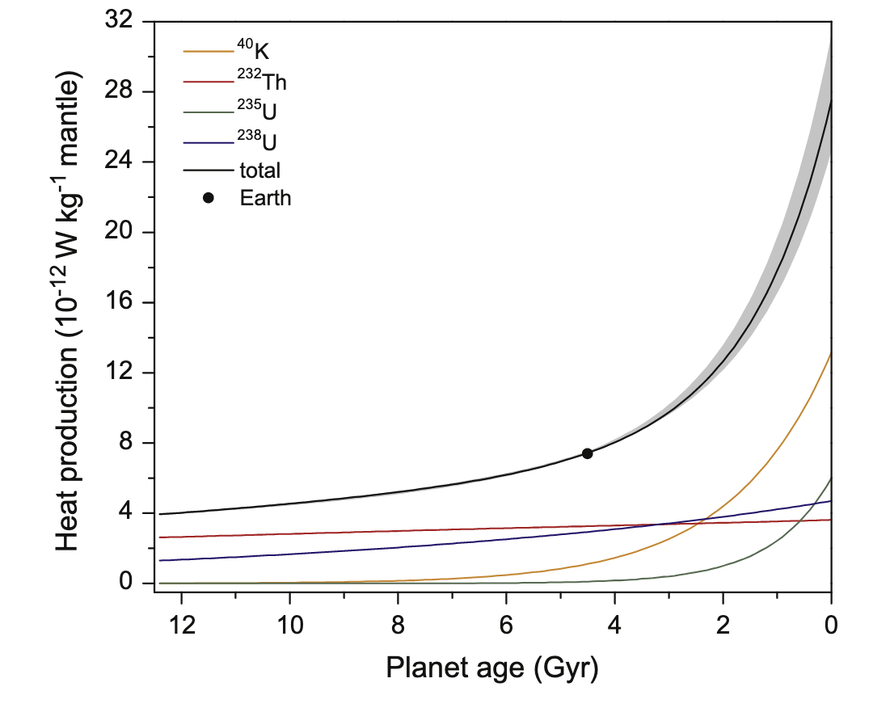
Mixing conditions could impact exoplanet habitability
Frank+2014

Slide 30
Making the p nuclei
Different stellar environments
3D hydrodynamic mixing profile, efficiency, and response to ingestion
p nuclei
stable seeds in the C-shell
Nuclear physics impact

Slide 31
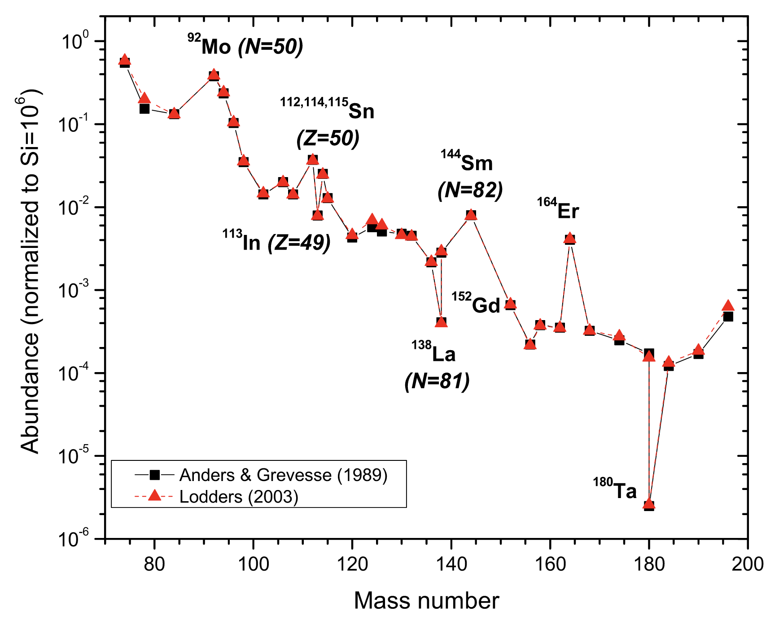
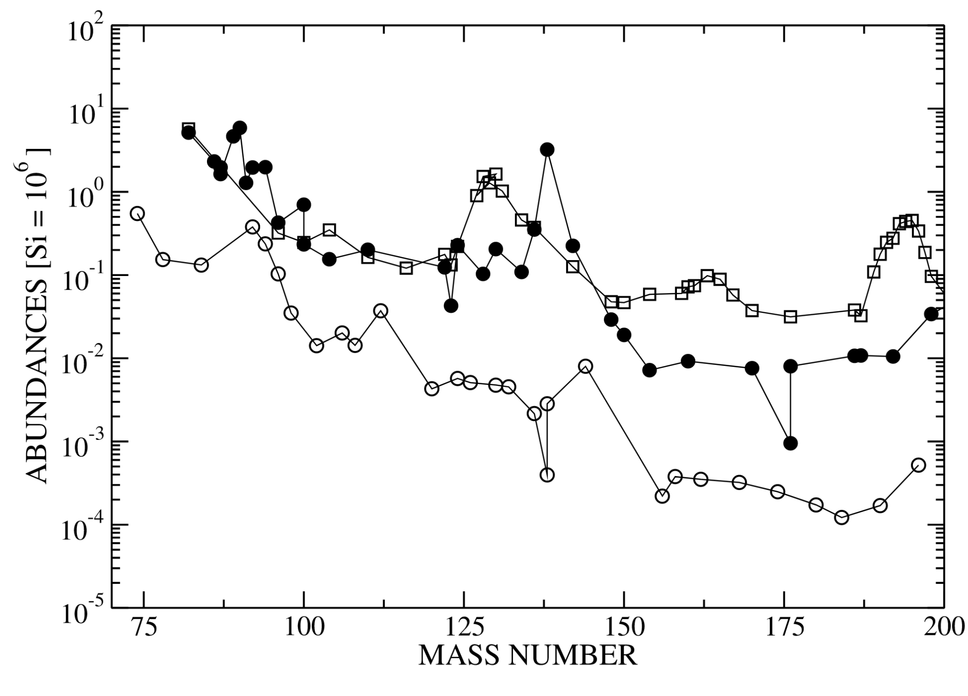
P nuclei measurements
Rauscher+2013
Rapp+2006

Slide 32
𝛾 process problems
¹⁵²Gd, ¹⁶⁴Er, ¹⁸⁰Ta have large s-process contributions.
¹¹³In and ¹¹⁵Sn can have r-process contributions.
¹³⁸La and ^{180m}Ta have ν-induced contributions.
𝛾 process underproduces p nuclei with A < 124 and 150 ⩽ A ⩽ 165.
Rauscher+2013

